Slide 1


Projects parts a & b progress presentation
Name: Marella MORAD
Student ID: 103076428

Slide 2

design problem
Projects A & B:
Eight Data Sets of pre-captured and digitized ECG samples that require analysis for heartrate values and ECG attributes that will be displayed:
Plots
Command window
Notes:
So in this slide we're going to talk about the design problems for both projects A&B we will have 8 sets of pre captured and digitized ECG samples that require analysis for heart rate values and ECG attributes that will be displayed graphically. Therefore, the main design problem in our project is to analyze these sets of ECG data.

Slide 3
Project goal
Project A
Design a Heart Rate Monitor
Project B
Design a Heart Rate Analyser
Notes:
Moving on, I will briefly discuss the project goals that are slightly different but very related in terms of the analysis done to them. so for project A, our main goal is to display the heart rate in BPM in the command window of a MATLAB program and in project B the main goal is to output a graphical demonstration of the important attributes in ECG data set selected these attributes include peaks, time intervals and duration as shown in the figure adapted from the project guidelines.

Slide 4
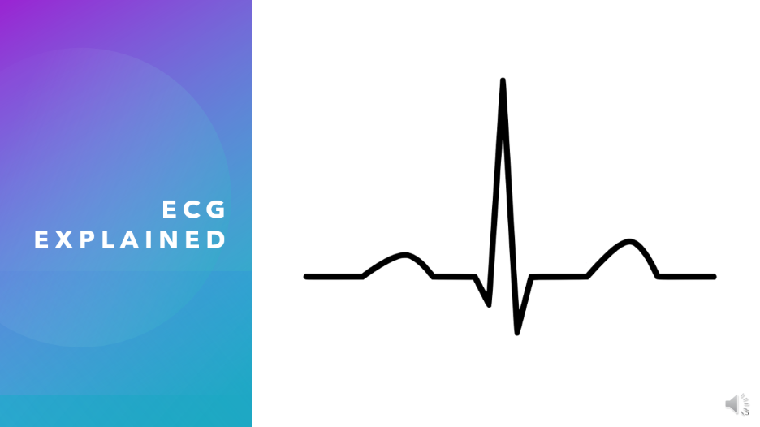

Project background research
ECG explained
Heartrate conversions
Filtering techniques
Points Identifications & Labeling
Notes:
In the background research I did for this project there were six topics that I covered the first one is how are ECG graphs explained how is time calculated of 1 cycle and then how to convert this time into heart rate some research about filtering techniques and then for project B how to identify points from a graph and then adding labels to them to design the analyzer

Slide 5
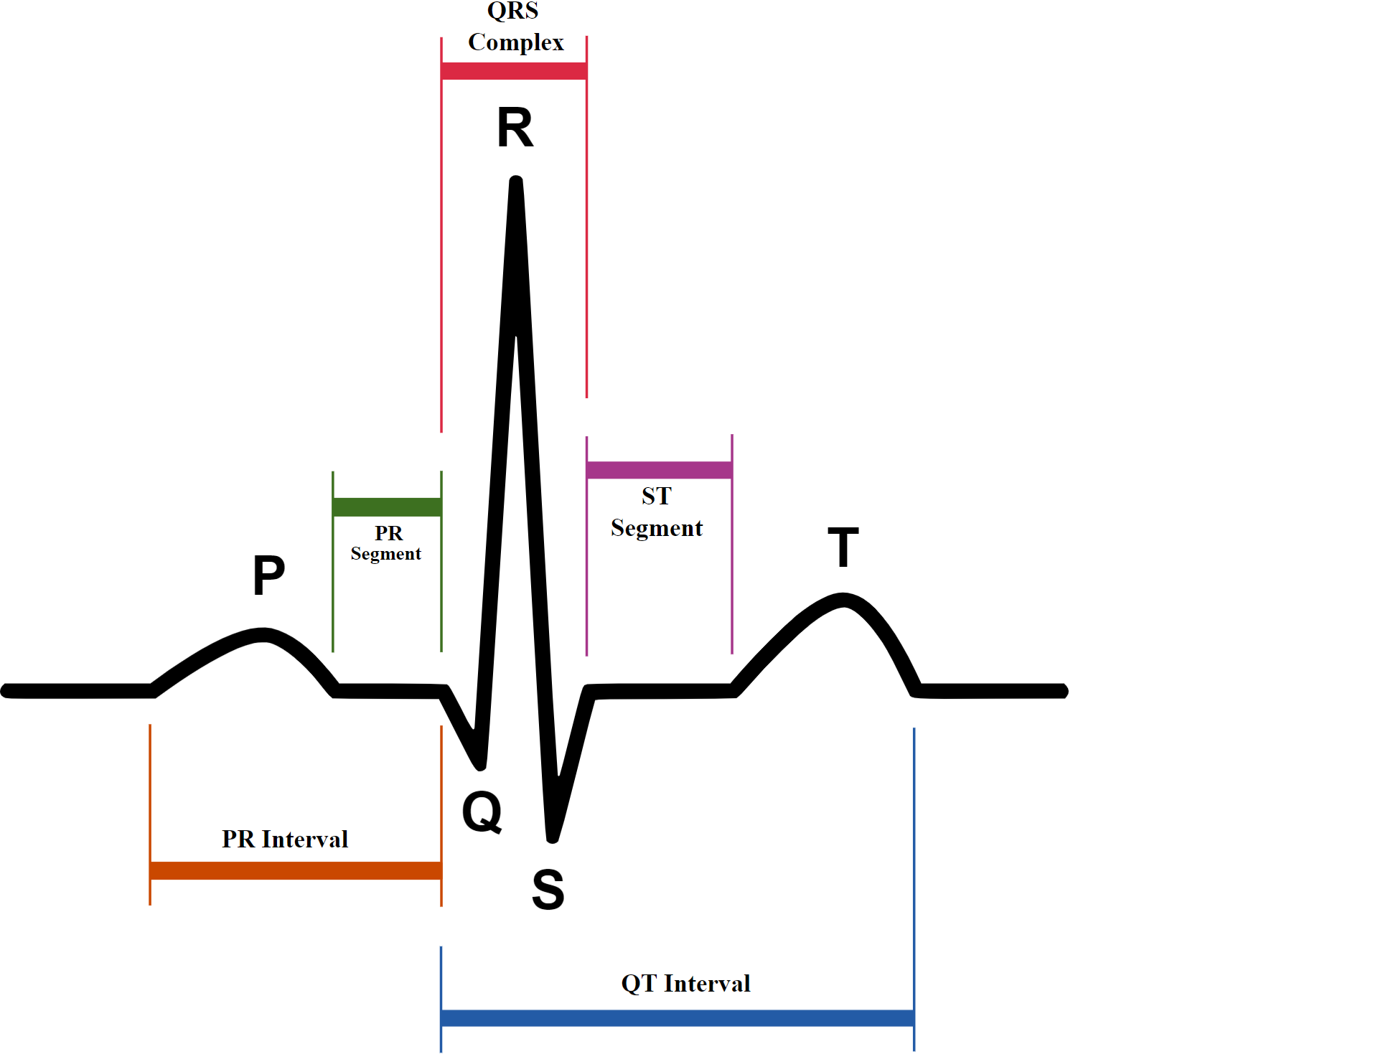
ECG Explained
QRS
Complex
P Wave
T Wave

Slide 6
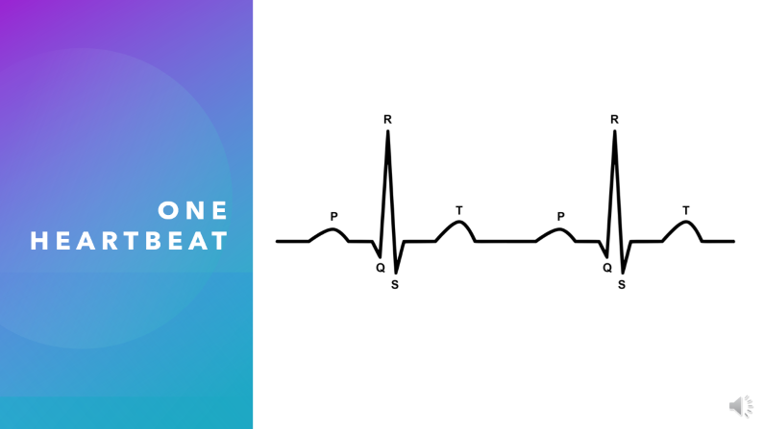
Project background research
ECG explained
Heartrate and time conversions
Filtering techniques
Points Identifications & Labeling
Notes:
In the background research I did for this project there were six topics that I covered the first one is how are ECG graphs explained how is time calculated of 1 cycle and then how to convert this time into heart rate some research about filtering techniques and then for project B how to identify points from a graph and then adding labels to them to design the analyzer

Slide 7
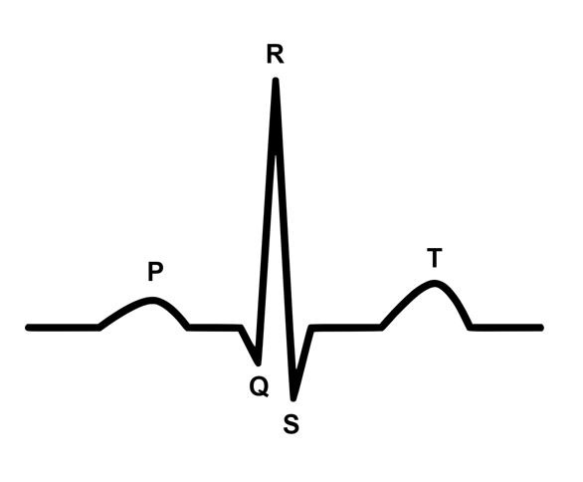

One heartbeat
One complete cycle
$$Heartrate in bpm= \frac{60}{\frac{time of one cycle in ms}{1,000}}= \frac{60,000}{time of one cycle in ms}$$

Slide 8
Project background research
ECG explained
Heartrate and time conversions
Filtering techniques
Points Identifications & Labeling
Notes:
In the background research I did for this project there were six topics that I covered the first one is how are ECG graphs explained how is time calculated of 1 cycle and then how to convert this time into heart rate some research about filtering techniques and then for project B how to identify points from a graph and then adding labels to them to design the analyzer

Slide 9
Design requirements – Project A
Provide an accurate value of the heartrate in bpm from the ECG data samples provided
Avoid any confusion to the user in terms of showing unnecessary components.

Slide 10
Design requirements Project B
Pre-filtering of the ECG data samples.
Identifying the important deflections in an ECG waveform (P, Q, R, S & T)
Displaying one wave of the sample with the attributes labelled on it.
Calculating average values for the time intervals ( P-R interval, Q-T interval, QRS duration)
Informing the user if they are out of the normal range

Slide 11
Design constraints - Both Projects
Only works with pre-recorded and digitized data, with a sample rate of 360 samples/s.
Only works using MATLAB, given that the samples are already downloaded to the device storage.

Slide 12

Possible design solutions- Project A
Finding the peak values and their location at the same time using finpeaks()
Finding the peak values and searching for their indices
Finding the mean time difference using mean command in MATLAB
Finding the time to complete one cycle
Apply a suitable filtering technique
Convert to bpm and Display

Slide 13
Possible design solutions- Project b - Incomplete
Finding the requested time intervals
Find the peaks using the findpeaks() command
Labelling
Comparing to normal values
Apply a suitable filtering technique
Display

Slide 14
Resource needs
MATLAB
The eight Sample Data gathered using ECG and digitized to 360 samples per second

Slide 15
Timeline for estimated project activities
Analysis
State the problem
Requitements and Constraints
Design
Brainstorm possible solutions
Development
Communicate the Results
Create a prototype
Design the chosen Solution
Test the prototype
Re-design if required
Record the demo Video

Slide 16
Timeline for estimated project activities
Part A
Analysis
Design
Development
Communication of the results
Week 5
Week 6
Break
Week 7
Week 8
Week 9
Week 10
Week 11
Week 12
Analysis
Design
Development
Communication of the results
Part B

Slide 17
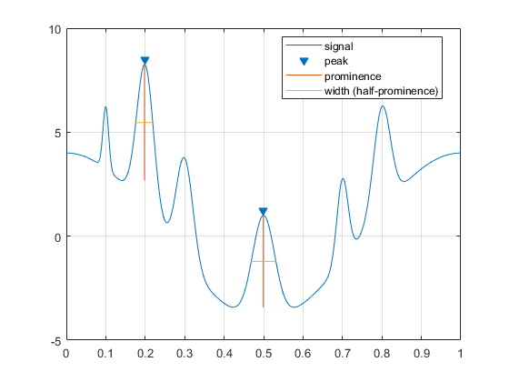
Peak prominence

Slide 18
Thank you for listening

